Slide 1
PIZZA SALES ANALYSIS
BY ARJUN MENON

Slide 2


1)Retrieve the total number of orders placed.

Slide 3
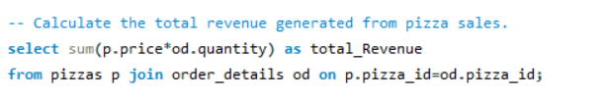

2) Calculate the total revenue generated from pizza sales.

Slide 4

3) Identify the highest-priced pizza.

Slide 5

4) Identify the most common pizza size ordered.

Slide 6
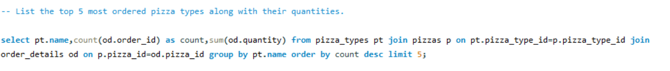
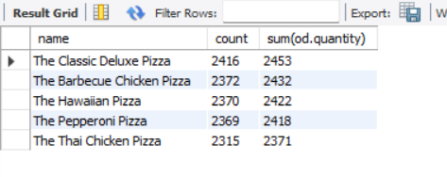
5) List the top 5 most ordered pizza types along with their quantities.

Slide 7
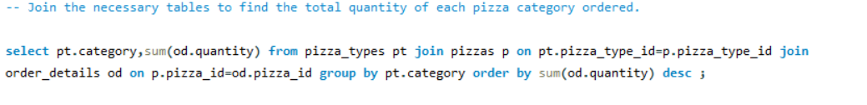
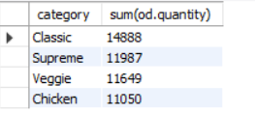
6) Join the necessary tables to find the total quantity of each pizza category ordered.

Slide 8
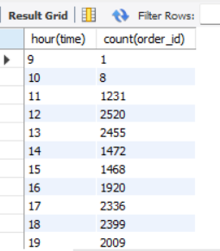
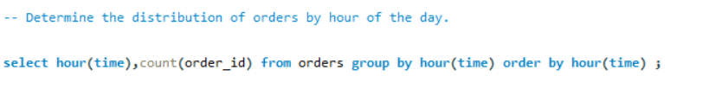
7) Determine the distribution of orders by hour of the day.

Slide 9
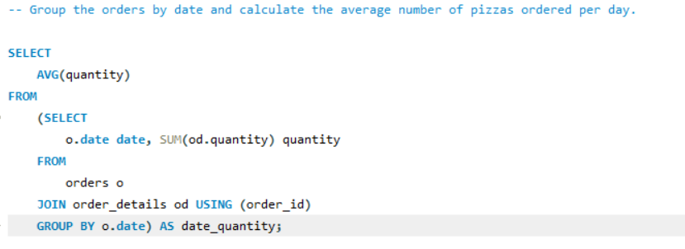

8) Group the orders by date and calculate the average number of pizzas ordered per day.

Slide 10
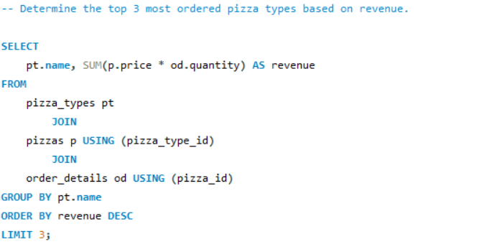
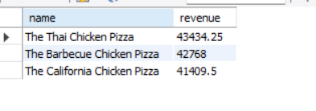
9) Determine the top 3 most ordered pizza types based on revenue.

Slide 11
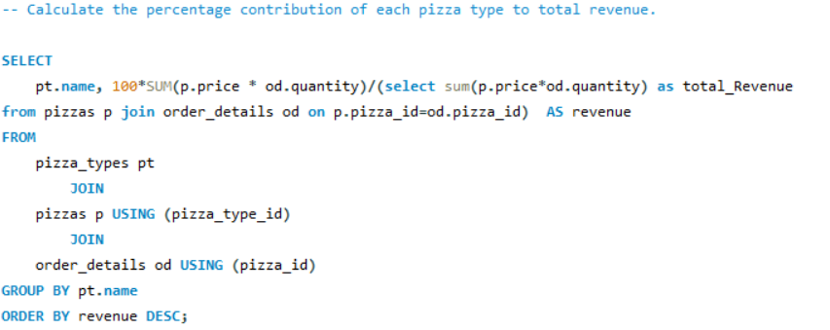
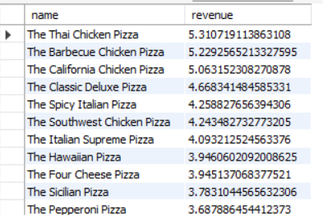
10) Calculate the percentage contribution of each pizza type to total revenue.

Slide 12
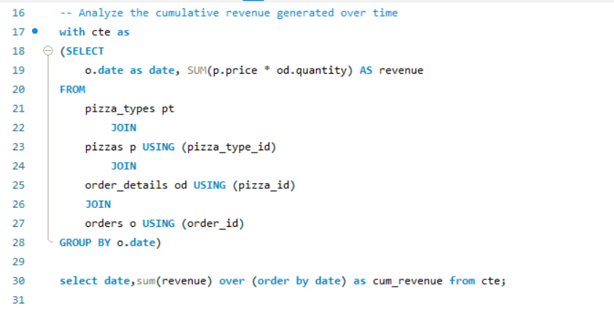
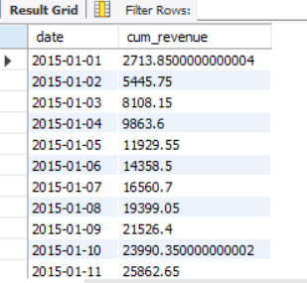
11) Analyze the cumulative revenue generated over time.

Slide 13
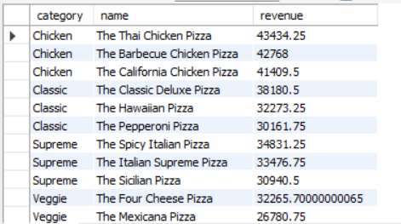
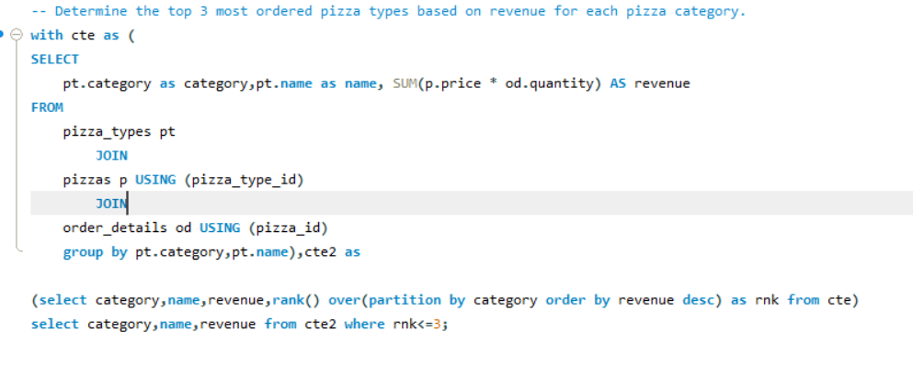
12) Determine the top 3 most ordered pizza types based on revenue for each pizza category.

Slide 14
THANK YOU EVERYONE
Special Thanks To Nancy Garg For Providing Dataset and support

